Slide 1
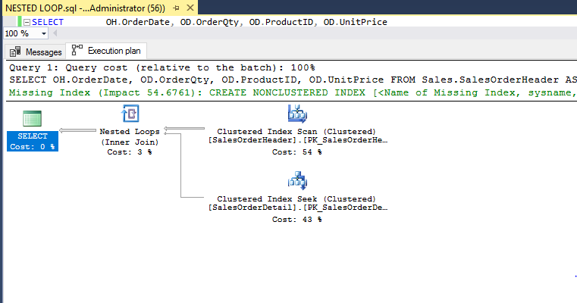
Example of joins in execution plan
What is a nested loop join? Hash Join? Merge join?
The operator on the top right is called the outer input
The just below it is called the inner input.

Slide 2
Every query simple or complex goes thru the query optimizer to get the most efficient execution plan
Execution plan
Query optimizer
Simple query
The query optimizer will go thru the process of validating the query and come up with the best execution plan for this query
Select firstname, lastname
from people
STATISTICS
The optimizer uses the statistics to determine the most efficient execution plan to create
https://docs.microsoft.com/en-us/sql/t-sql/database-console-commands/dbcc-show-statistics-transact-sql

